Slide 1

Restaurant Rush
CT2003 OBJECT-ORIENTED DESIGN & PROGRAMMING · 26S1
Oral presentation · COMP1 · Group 3 · 14 November 2026
Soon How
Kenz
1 Launch · 7 Stage tags
2 Manager choices · 6 Win and loss
Danial
Rifqi
3 READY to paid · 5 Stage 3
4 VIP or Critic · 7 Class diagram
Notes:
SOON HOW · about 30 seconds
SAY:
Good [morning / afternoon]. We are Group 3 from lab group COMP1, and this is Restaurant Rush. I am Soon How. With me are Kenz, Danial and Rifqi.
Restaurant Rush is a turn-based restaurant game played on the command line. The player is the manager. There is one Waiter, one Chef and one Cashier, so each turn the manager decides what the staff do.
We will go through seven segments. Each one is shown from the project we submitted. I will start by launching the game.
DO:
Have the terminal already open in the project folder before we start.

Slide 2

Seven segments, live from the submitted project
RUN SHEET · 15 MINUTES · ALL FOUR PRESENT
# | Segment (from the brief) | Presenter | Min | What we show
– | Opening | Soon How | 0.5 | Team and run sheet
1 | The game launching from the submitted project | Soon How | 1.5 | Compile, run, base setting
2 | Manager choices, incl. staff constrained | Kenz | 2 | Turn 10: serve a dish or seat a customer
3 | A dish going READY → SERVED → payment | Danial | 2 | Customer 1's Salad, turns 2 to 5
4 | A VIP or Critic behaviour | Rifqi | 2 | VIP, turn 4
5 | A Stage 3 feature | Danial | 2 | ComboMeal [+ Host / Happy Hour]
6 | One victory and one defeat | Kenz | 2 | Replays from testing/
7a | Stage tag comparisons | Soon How | 1.5 | GitHub compare views
7b | Class diagram | Rifqi | 1.5 | Final diagram, annotated
CT2003 Restaurant Rush · Group 3
2
Notes:
OPTIONAL SLIDE · 5 seconds, or hide it and keep it as our cue sheet
SAY (only if shown):
This is our order for the next 15 minutes. Each of us presents two parts.
FOR US:
The timings add up to 15 minutes. Rehearse with a timer. If we run long, cut from segment 1.
The turns in the last column come from the run in testing/stage1-victory-input.txt. Check them again on the final stage-3 build.

Slide 3
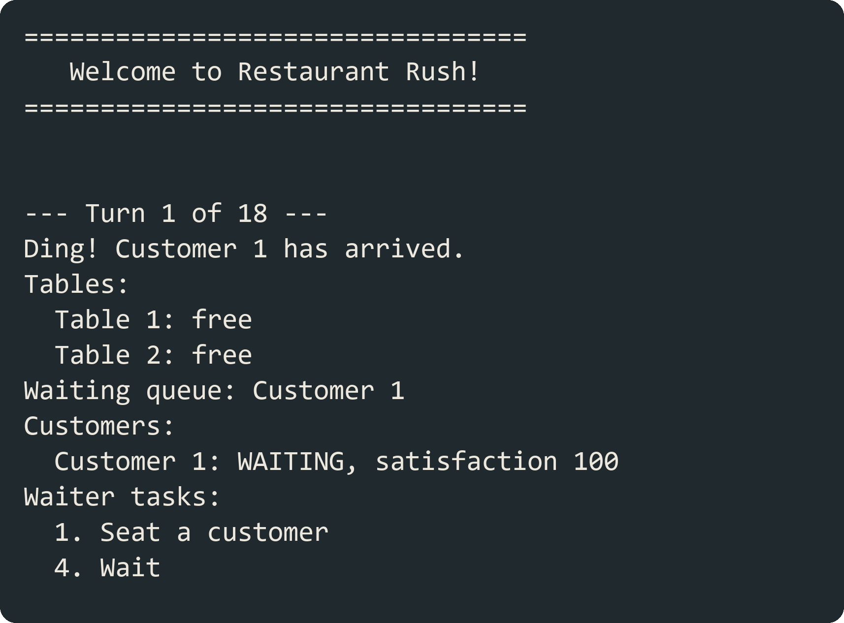
Launching the game from the submitted project
SEGMENT 1 · SOON HOW · 1.5 MIN
1. Compile from a fresh clone at stage-3
javac -d out $(find src/main/java -name "*.java")
2. Run and pick the base setting
java -cp out Main
3. Read the start-of-turn display
Turn, revenue, average satisfaction, waiting queue, 2 tables, staff tasks available
CT2003 Restaurant Rush · Group 3
3
Notes:
SEGMENT 1 · SOON HOW · 1.5 minutes
DO:
Switch to the terminal. Show the project folder as submitted, at the stage-3 tag.
SAY:
This is the project folder as we submitted it. I compile every source file into the out folder with one javac command.
(Run the javac command.)
Then I start the game with java -cp out Main.
(Run it.)
The game uses one fixed base setting, so anyone can reproduce our runs. It has 18 turns and 2 tables. There is one Waiter, one Chef and one Cashier. One customer arrives on turns 1, 4, 7, 10, 13 and 16.
To win, after turn 18 we need at least 4 paid customers, at least 45 dollars of revenue, and an average satisfaction of at least 60 among the customers who paid.
This is the start of turn 1. The first line is the turn number. Customer 1 has just arrived. Both tables are free. The waiting queue has Customer 1, with satisfaction at 100. Below that are the Waiter tasks that are possible this turn. Only seating and waiting are offered, because nobody has ordered yet.
Kenz will now show the choices the manager makes.
FOR US:
The screenshot on the slide is the real output of the stage 1 build. Retake it on the stage-3 build.
The slide says "pick the base setting" and lists revenue and average satisfaction in the display. The current build does not ask for a setting and does not show those two at the start of a turn. Change the slide or the display before we present.

Slide 4
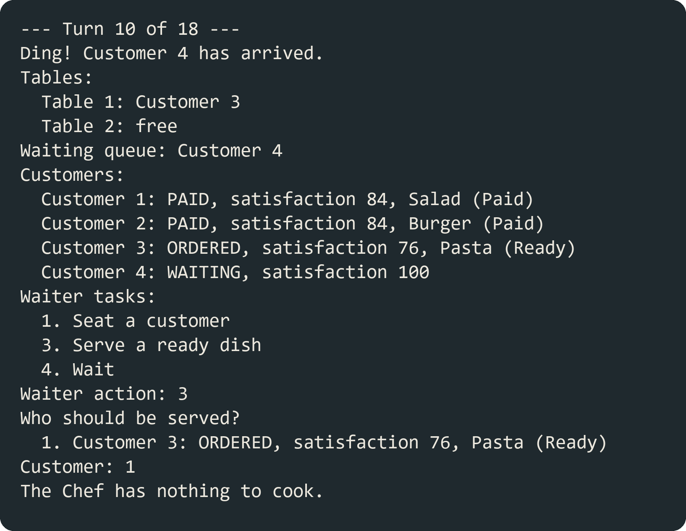
Manager choices when staff time runs short
SEGMENT 2 · KENZ · 2 MIN
Waiter: one task a turn
Seat · take an order · serve a READY dish · wait
Chef: one prep unit a turn
Cook one unit of one order · wait
The constrained decision we show
Turn 10: Customer 4 waits for a table while Customer 3's Pasta is READY. The Waiter can do only one. We serve first, because Customer 3 has waited longest.
Invalid choice: the reason is shown and the staff task is not used up.
CT2003 Restaurant Rush · Group 3
4
Notes:
SEGMENT 2 · KENZ · 2 minutes
SAY:
Thank you, Soon How. The manager controls two staff members each turn. The Waiter can do one task: seat a customer, take an order, serve a dish that is READY, or wait. The Chef can cook one preparation unit of one order, or wait. The game only lists the tasks that are possible on that turn.
The hard turns are the ones where the Waiter has two useful things to do. This is turn 10 in our run. Customer 4 has just arrived and is waiting for a table. At the same time, Customer 3's Pasta is READY. The Waiter can do only one of these.
We serve the Pasta first. Customer 3 has waited the longest, and a customer stops losing satisfaction once the dish is served. Customer 4 has only just arrived, so one more turn in the queue costs one turn of satisfaction.
(Type 3 to serve, then 1 for Customer 3.)
On turn 11 the Waiter seats Customer 4.
Every turn without food costs a Regular customer 8 satisfaction, a VIP 5 and a Critic 12. So the order of the Waiter's tasks changes the final score.
The game also handles wrong input. If I type a letter, it asks for a number. If I pick a task that is not possible this turn, for example Take an order when nobody is seated, it says Not allowed and gives the reason. The Waiter's task is not used up, and I choose again.
(Show one invalid choice.)
Danial will now follow one dish from the kitchen to payment.
FOR US:
Turn 10 comes after the turns used in segments 3 and 4. If we play one game live from turn 1, either use the screenshot here or start this segment from a replay that stops at turn 10.
The screenshot is the real output of the stage 1 build. Retake it on the stage-3 build. From Stage 2 Customer 3 is the Critic, so the satisfaction number on screen will be lower than 76.

Slide 5

One dish from READY to payment
SEGMENT 3 · DANIAL · 2 MIN
RECEIVED
READY
SERVED
READY_TO_PAY
PAID
Waiter takes the order; price locked
Chef finishes the last unit
Waiter serves, next turn at the earliest
After one full turn eating
Cashier collects, oldest first; table freed
Turn | What happens in our run | Satisfaction at turn end
2 | Chef finishes the last unit of Customer 1's Salad: READY. Waiter has already acted | 84
3 | Waiter serves: SERVED. No more satisfaction loss | 84
4 | Customer finishes eating: READY_TO_PAY | 84
5 | Cashier collects $9.00: PAID, table freed, satisfaction recorded | 84
CT2003 Restaurant Rush · Group 3
5
Notes:
SEGMENT 3 · DANIAL · 2 minutes
SAY:
Thank you, Kenz. I will follow one dish through its statuses. It is Customer 1's Salad, from the same run.
On turn 2 the Waiter takes the order. The order is created and its price is locked at 9 dollars. On the same turn the Chef cooks its one preparation unit, so the Salad becomes READY.
It cannot be served on turn 2. The Waiter acts before the Chef in every turn, and the Waiter has already used this turn to take the order. So the earliest the dish can be served is turn 3.
On turn 3 the Waiter serves it, and the order is SERVED. From here the customer stops losing satisfaction. It stays at 84.
The customer eats for one full turn and is READY_TO_PAY at the end of turn 4. On turn 5 the Cashier collects 9 dollars. The order is PAID, Table 1 is free again, and the satisfaction of 84 is recorded for the final average.
On the design side, this is encapsulation. Order keeps its own status and its locked price. Other classes cannot set the status directly. They call Order's own methods, such as markServed and markPaid, and Order refuses a change that is out of sequence. For example, an order that is not READY cannot be served.
Rifqi will now show how different customers behave.
FOR US:
The brief's reference case is a Pasta customer who arrives on turn 1 and pays 18 dollars on turn 6 with 76 recorded. Our Salad needs one unit less, so it pays one turn earlier, on turn 5 with 84.
The first box on the slide says PLACED. The status in OrderStatus is RECEIVED. Use one name in both places.

Slide 6
VIP and Critic: same turn, different behaviour
SEGMENT 4 · RIFQI · 2 MIN
Customer | Loss per unserved turn | Bill | Extra behaviour
RegularCustomer | 8 | Full price | None
VIPCustomer | 5 | 10% off ($15.00 Burger bills $13.50) | None
CriticCustomer | 12 | Full price | Orders the slowest dish (Pasta)
Polymorphism, not if-chains
What we show live
GameController calls loseSatisfaction(), chooseItem() and applyDiscount() on any Customer. It never checks the type.
VIP on turn 4: satisfaction 100, 95, 90 while waiting. The $15.00 Burger bills $13.50. Critic on turn 10: orders Pasta (a Regular would get Salad) and drops 100, 88, 76, 64, 52.
CT2003 Restaurant Rush · Group 3
6
Notes:
SEGMENT 4 · RIFQI · 2 minutes
SAY:
Thanks, Danial. From Stage 2 we have three types of customer. A Regular loses 8 satisfaction for every turn they wait without food, and pays full price. A VIP is more patient: they only lose 5, and get 10% off the bill. A Critic is the opposite. They lose 12 a turn, pay full price, and always order the dish that takes the longest to cook, which is the Pasta.
(Point at Customer 2.) Customer 2, who comes in on turn 4, is our VIP. Satisfaction starts at 100, then 95, then 90. A Regular would already be down to 84 by now. He orders a Burger. The menu price is 15 dollars, and he pays 13 dollars 50.
(Point at Customer 4.) The Critic comes in on turn 10. He is customer 4, so a Regular in his place would order the Salad, but he orders the Pasta. You can see him drop fast: 100, 88, 76, 64, and he is at 52 by the time his food is ready. Pasta takes the Chef 2 turns, so the Critic really tests the kitchen.
Now how it is built. Customer is an abstract parent class, and each type only fills in what is different: its satisfaction loss, the VIP's discount and the Critic's food choice. GameController calls the same methods on every customer, loseSatisfaction, chooseItem and applyDiscount, and it never checks what type the customer is. That is why adding the VIP and the Critic in Stage 2 did not change the Waiter, Chef, Cashier or Order.
Danial will now show a Stage 3 feature.
IF ASKED:
Who calls getSatisfactionLoss()? loseSatisfaction() is written once in Customer. It asks the subclass for the amount through getSatisfactionLoss(), and stops at 0.
Can a VIP walk out? Not in this game. Losing 5 a turn takes 20 turns to reach 0, and the game is 18 turns.
Why is applyDiscount() not abstract? Regular and Critic both pay full price, so that is the default in Customer, and only the VIP overrides it.

Slide 7
Stage 3: ComboMeal, with Host and Happy Hour
SEGMENT 5 · DANIAL · 2 MIN
SHOWN LIVE
ALSO IN STAGE-3
ALSO IN STAGE-3
ComboMeal
Host
Happy Hour
Two dishes in one order. Prep units are summed; price is 90% of the two.
Seats one extra customer a turn, through the same Restaurant.seat() the Waiter uses.
Once a game, 2 turns: 20% off new orders, +15 satisfaction. VIP discount applies first.
Salad + Pasta = ($9.00 + $18.00) × 0.9 = $24.30, 3 units
VIP Burger: $15.00 × 0.9 × 0.8 = $10.80
Composition: a ComboMeal holds two MenuItems and is itself a MenuItem.
CT2003 Restaurant Rush · Group 3
7
Notes:
SEGMENT 5 · DANIAL · 2 minutes
SAY:
Thank you, Rifqi. Stage 3 adds three things: a ComboMeal, a Host and Happy Hour. I will show the ComboMeal live.
A ComboMeal is two dishes sold as one order. Here the customer orders the Salad and Pasta combo.
(Take the combo order and point at the price.)
The price is 90% of the two dishes together. 9 dollars plus 18 dollars is 27 dollars, and 90% of that is 24 dollars 30. The price is locked when the order is taken, like any other order.
The preparation units are added up. Salad needs 1 and Pasta needs 2, so the Chef needs 3 turns of work on this order.
(Point at the Chef task showing 3 units left.)
So a combo earns more from one table but keeps the kitchen busy for longer. The manager has to plan for that.
The design here is composition. A ComboMeal holds two MenuItems, and it is also a MenuItem itself. So Order, Chef and Cashier treat it like any other dish.
Briefly, the other two features. The Host seats one extra customer a turn, using the same seat method as the Waiter. Happy Hour can be used once a game and lasts 2 turns. New orders get 20% off and satisfaction goes up by 15. A VIP's 10% discount is applied first, so a VIP Burger costs 10 dollars 80.
Kenz will now show a win and a loss.
FOR US:
Stage 3 is not in the game yet, so this slide has no screenshot and the script follows the design on the slide. The ComboMeal price and unit rules match ComboMeal.java on Danial's branch. Check every line of this script against the stage-3 build before we present.

Slide 8
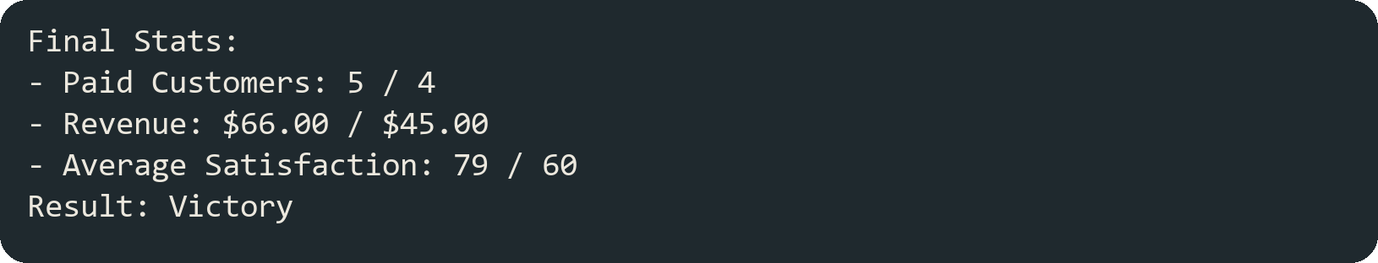
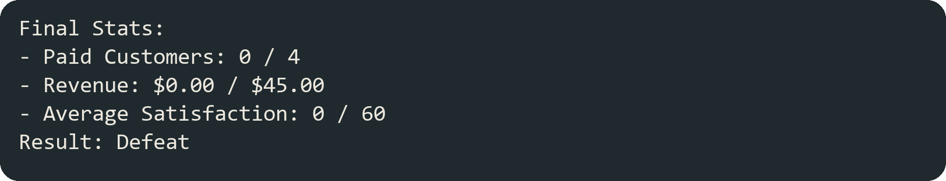
One victory and one defeat, both reproducible
SEGMENT 6 · KENZ · 2 MIN
Victory
Defeat
Target | Needed | Ours
Paid customers | 4+ | 5
Revenue | $45.00+ | $66.00
Avg satisfaction | 60+ | 79
Target | Needed | Ours
Paid customers | 4+ | 0
Revenue | $45.00+ | $0.00
Avg satisfaction | 60+ | 0
testing/stage1-victory-input.txt
testing/stage1-defeat-input.txt
Replay: java -cp out Main < input file · two separate runs
CT2003 Restaurant Rush · Group 3
8
Notes:
SEGMENT 6 · KENZ · 2 minutes
SAY:
Thank you, Danial. The brief asks for one victory and one defeat. We saved the inputs for both as text files in the testing folder, so anyone can replay them and get the same result.
First the victory. I pipe the input file into the game.
(Run the victory replay.)
All 18 turns play in a few seconds. At the end, 5 customers have paid, against a target of 4. Revenue is 66 dollars, against 45. Average satisfaction is 79, against 60. All three targets are met, so the result is Victory.
In this run every dish is served on the turn after it is ready, so the customers lose little satisfaction.
Now the defeat.
(Run the defeat replay.)
Here the manager makes the Waiter wait on every turn. Nobody is seated, so nobody orders. Customer 1 and Customer 2 run out of patience, reach 0 satisfaction and leave without paying. At the end there are 0 paid customers and no revenue, so the result is Defeat.
The game checks all three targets after turn 18. Missing any one of them is a defeat.
Soon How will now show how the project grew across the three stages.
FOR US:
The numbers and the two screenshots are from the stage 1 replays, run on the current dev branch. Replace them with the stage-3 replays when Kenz has recorded them.

Slide 9
Three tagged stages, each runnable on its own
SEGMENT 7A · SOON HOW · 1.5 MIN
stage-1
stage-2
stage-3
Basic operation
Customer behaviour
Host, ComboMeal, Happy Hour
Danial’s Order class left out one rule. His commit said: “a dish that turns READY this turn must not be served until next turn. This rule belongs in turn controller.”
Modify turn order: the Waiter always acts before the Chef, so a freshly cooked dish waits a turn.
Two parts of the program were both reading the keyboard, which broke our test replays. We fixed it by making Kenz’s InputReader the only reader.
Rifqi added the VIP and Critic customers.
He gave each customer a getTypeName() method, and Kenz’s display uses it to show the type on screen.
Rifqi asked whether the Critic should arrive on turn 7 or turn 10. We chose turn 7, so his special dish choice actually shows.
I connect everyone’s new pieces into the turn sequence:
Kenz’s Host;
Danial’s combo meal and Happy Hour prices;
Rifqi’s satisfaction boost.
Commit 5609a16
Compare stage-1...stage-2
Compare stage-2...stage-3
github.com/armaldro/2003-Group3 · the README lists every new, changed and deleted file with its reason
CT2003 Restaurant Rush · Group 3
9
Notes:
SEGMENT 7A · SOON HOW · 1.5 minutes
SAY:
Thank you, Kenz. We built the project in three stages, and each stage is a tag in our GitHub repository. Each tag is a version that compiles and runs on its own.
(Open the tags list on GitHub.)
Stage 1 is the basic operation: Regular customers, three dishes, the Waiter, Chef and Cashier, the full turn sequence and both endings.
(Open the compare view stage-1...stage-2.)
Stage 2 adds the VIP and the Critic. The main change in my part is in GameController. In Stage 1, handleArrivals created a Regular customer directly. Now the arrival schedule in GameConfig says which type of customer arrives on each turn, and handleArrivals asks the schedule to create it. Waiter, Chef, Cashier, Order and Restaurant did not change.
(Open the compare view stage-2...stage-3.)
Stage 3 adds the Host, the ComboMeal and Happy Hour. [One sentence on the main change and why, once stage 3 is merged.]
Our README lists every new, changed and deleted file for each stage, with the reason. The source code at each tag shows the stage as well, so you can check out any tag and run it.
Rifqi will close with the class diagram.
FOR US:
Only the stage-1 tag exists today, at commit 5609a16. The file counts for stage-2 and stage-3 stay blank until those tags exist. Take them from the README stage sections.

Slide 10
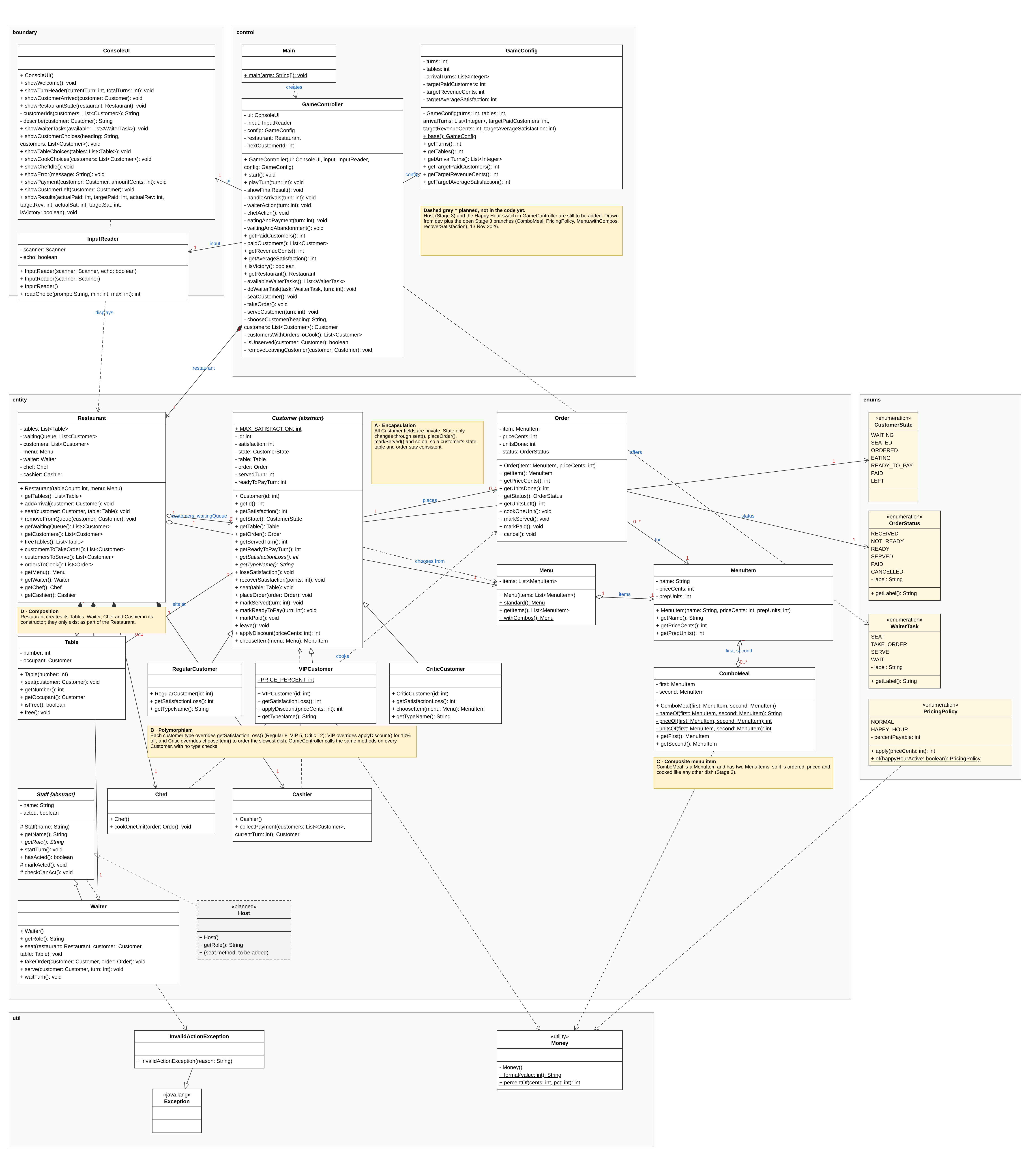
The final class diagram, matching stage-3
A · Encapsulation
Customer and Order keep their fields private and change only through their own methods
B · Polymorphism
Regular, VIP and Critic extend Customer and override loss, discount and food choice
C · Inheritance + aggregation
ComboMeal is a MenuItem and holds two MenuItems
D · Composition
Restaurant creates its Tables, Waiter, Chef and Cashier; they only exist as part of it
CT2003 Restaurant Rush · Group 3
10
Notes:
SEGMENT 7B · RIFQI · 1.5 minutes
SAY:
Thanks, Soon How. This is our final class diagram.
The classes are grouped into packages. Entity holds the data and the rules, like Customer, Order, Table and the staff. Control has the game logic, mainly GameController and GameConfig. Boundary does all the console input and output. Then there are the enums, and a small util package for money.
I will go through the four yellow notes.
A is encapsulation. Customer and Order keep all their fields private. A customer's state only changes through methods like seat, placeOrder and markServed, and an order's price is locked when it is created.
B is polymorphism. Regular, VIP and Critic all extend Customer and only override what is different, so the rest of the game just works with Customer.
C is the ComboMeal. It is a MenuItem, and it also holds two MenuItems, so an order can hold a combo the same way as a single dish. We drew it as aggregation, because the two dishes also exist on the menu on their own.
D is composition. The Restaurant creates its own tables, Waiter, Chef and Cashier, and they only exist as part of the Restaurant.
These choices are why Stage 2 and Stage 3 could be added without rewriting Stage 1. That is the end of our presentation. Thank you.
DO:
If the diagram is too small on the projector, open diagrams/RestaurantRush-ClassDiagram.png full screen and zoom into the note being explained.

Slide 11
Thank you. Questions?
github.com/armaldro/2003-Group3
SOON HOW · KENZ · DANIAL · RIFQI
Notes:
ALL · questions
SAY (Soon How):
Thank you. We are happy to take questions.
FOR US:
The person who owns the area answers.
Customers: Rifqi.
Menu, orders and pricing: Danial.
Tables, Waiter, Host and console: Kenz.
Turn sequence, scoring and stages: Soon How.

